Slide 1
Topic :Clustering-Classification Approach For Human Activity Detection Using Smartphone Dataset
Shantanu Agrawal
1901182
Course: CS360 - Machine Learning Lab

Slide 2
Problem Definition

Slide 3
Problem Definition
The objective of this project is to recognize 6 activity of a human (Sitting, Standing, Laying, Walking, Walking Downstairs, Walking Upstairs ) by using gyroscope and accelerometer sensor data using smart phone
Topics/Models Covered
Classification
Clustering
Logistic Regression
Perceptron
K-Means
K-Medoid
Single Layer Perceptron
Fuzzy
SOM
Multi Layer Perceptron

Slide 4
Literature Survey

Slide 5
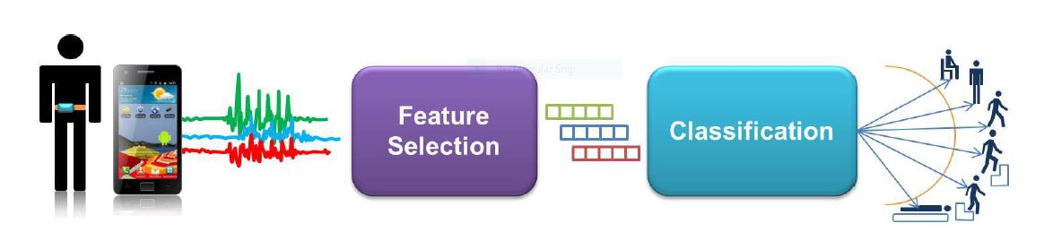
Literature Survey
Paper : Human Activity Recognition on Smartphones for Mobile Context Awareness
By Davide Anguita, Alessandro Ghio, Luca Oneto, Xavier Parra, Jorge L. Reyes-Ortiz
Setup
Support Vector Machine(SVM) Algorithm used.
Uses One-VS-All Approach for classification.
Reason of using smartphone for collecting data is the high number of growth in the user in last decade and the needed sensors like gyroscope, accelerometer hardware are already present.
In this paper, researchers are improving SVM to be used on resource limited devices by extending SVM to Hardware-Friendly SVM (HF-SVM) then to Multiclass HF-SVM (MC-HF-SVM).
Use of MC-HF-SVM can be smartwatch since it has very small resources available.

Slide 6
Literature Survey
Paper : A Public Domain Dataset for Real-Life Human Activity Recognition Using Smartphone Sensors By Daniel, Daniel, Enrique and Miguel
The main idea is to make activity recognition use more real world data than the model data provided under UCI Human Activities Recognition (HAR) repository
Support Vector Machine(SVM) Algorithm used due to fixed-point arithmetic data points. .
Uses One-VS-All Approach for classification.
Since the real world data is more unorganized, the first step is to organize it and make it easier to work with.
More sensors are used to collect data, like GPS, Magnetometer and more types of activities recognition is aimed forUse of MC-HF-SVM can be smartwatch since it has very small resources available.
Accuracy is slightly lower than previous works due to more real world data.

Slide 7
Literature Survey
Paper : A Smartphone-Based Adaptive Recognition and Real-Time Monitoring System for Human Activities By Wen, Hang and Andrea
Main idea is introduction of real-time human activity monitoring system and a adaptive learning environment.
Unsupervised learning algorithm as we want to classify new unrecognized activity and add a label to it for future classification. This new label will be added to the class.
Researchers are aiming for online learning algorithm which will be efficient in the terms of resources
Hierarchical clustering has been used to learning

Slide 8
Result Analysis

Slide 9
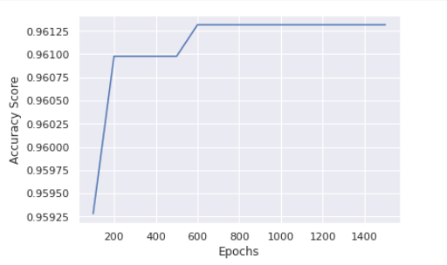
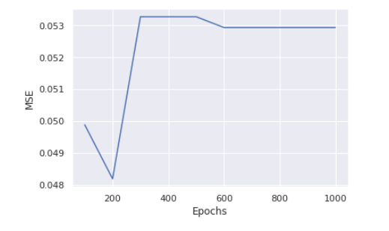
Classification : Logistic Regression
As shown in fig 1.1 by on varying epoch accuracy score
Around 600 epochs convergence occur
After 1000 epochs iteration
Train Accuracy Score : 99.25%
Test Accuracy Score : 96.13%
Log Loss Error : 0.119389576982268
Mean Squared Error : 0.05293518832711232
Fig:
1.1
Faster compare to other models
Epoch vs Mean Squared error (Fig : 1.2)
Model is performing well since it is achieving
96.13% accuracy
Fig : 1.2

Slide 10
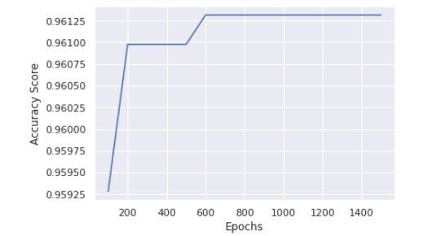
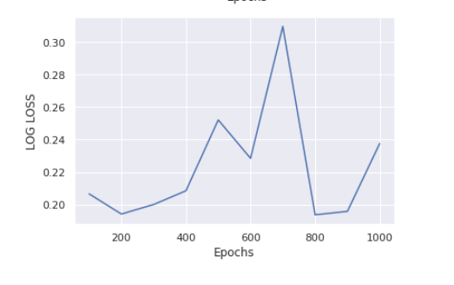
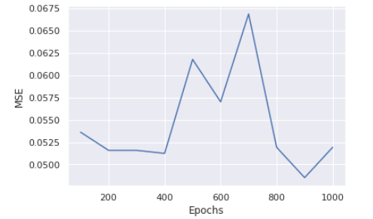
Classification : Stochastic Gradient Descent (ONE Vs ALL)
As shown in Fig 2.1 we plot Accuracy vs epoch graph
Around 800 epoch accuracy is similar
After 1000 iterations
Train Accuracy Score : 98.59%
Test Accuracy Score : 96.13%
Mean Squared Error : 0.04784526637258229
Log Loss Error : 0.2194638846322902
Fig : 2.1
K-Fold Cross-validation is a statistical method used to estimate the skill of machine learning models.
After K-Fold Validation
Accuracy Score : 94.63%
Fig:
2.3
MSE vs Epoch (fig : 2.2)
Log Loss vs Epoch (fig : 2.3)

Slide 11
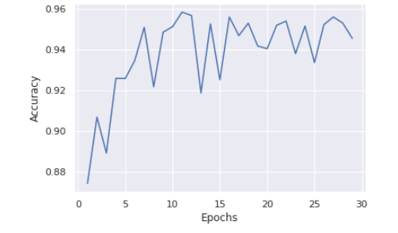
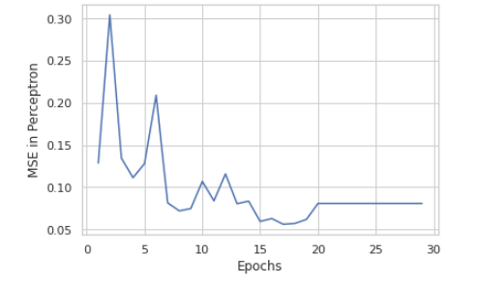
Classification : Perceptron
It does not require a learning rate
It updates its model only on mistakes.
Fig: 3.1
As shown in fig 3.1 by on varying epoch accuracy score
After 30 epochs iteration
Train Accuracy Score : 95.06%
Test Accuracy Score : 90.73%
Mean Squared Error : 0.10960298608754666
In MSE vs Epoch (fig : 3.2)
After 20 epoch MSE is almost
constant
Fig: 3.2

Slide 12
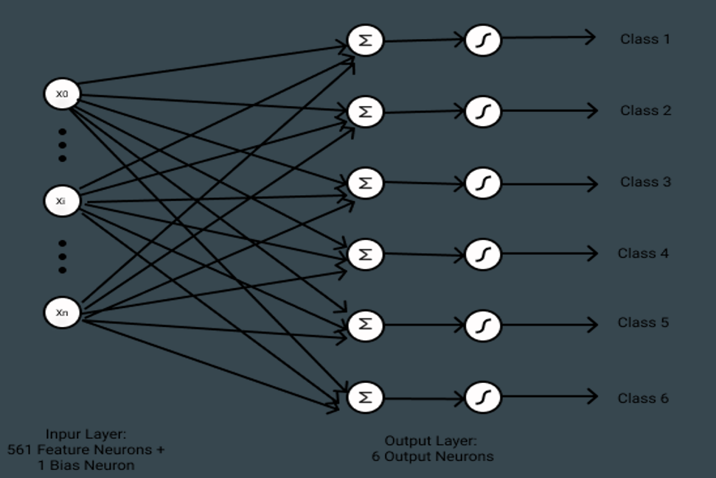
Classification : Single Layer Perceptron (SLP)
It is a feed-forward neural network
It has a single layer of perceptrons or artificial neurons. It updates its model only on mistakes.
Architecture

Slide 13
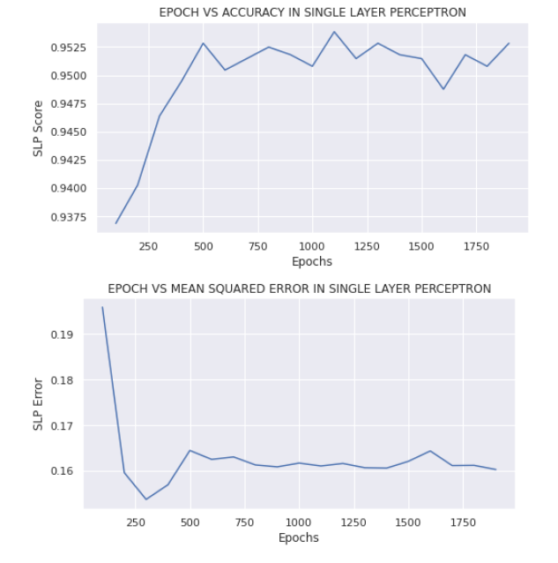
Classification : Single Layer Perceptron (SLP)
Slower compared to other models
Sigmoid activation function is used
Model converges with high accuracy
Higher accuracy achieved 95.35%

Slide 14
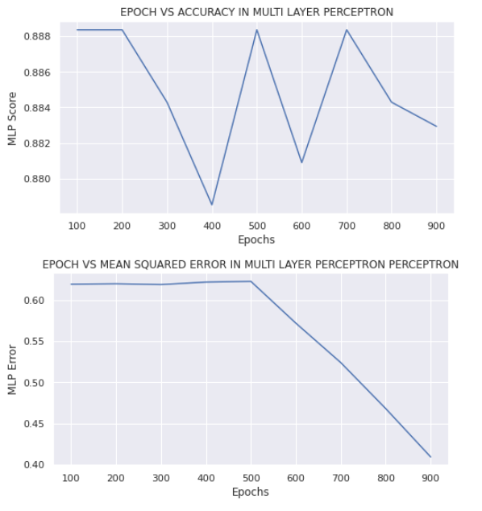
Classification : Multi Layer Perceptron (MLP)
It has one input layer, one output layer, and multiple hidden layers (feed-forward architecture).
No of hidden neuron taken is 562
Slow to train for increased number of layers and nodes
Slow to predict in case of large number of layers
Not suitable for real time accurate computations
Highest accuracy achieved 88.89%

Slide 15
Clustering
Fast compared to other models.
Algorithms Used – K-Means, K-Medoids, Fuzzy Clustering, SOM
Model converges with very low accuracy
Highest Accuracy achieved in K-Means – 32.37%
Highest Accuracy achieved in K-Medoid – 20.0543%
Highest Accuracy achieved in Fuzzy – 24.8728%
Highest Accuracy achieved in SOM – 9.3482%
Poor accuracy even with the reduced features.

Slide 16
Refernces
https://scikit-learn.org/stable/modules/generated/sklearn.linear_model.LogisticRegression.html
https://scikit-learn.org/stable/modules/generated/sklearn.linear_model.SGDClassifier.html
https://scikit-learn.org/stable/modules/generated/sklearn.linear_model.Perceptron.html
https://scikit-learn.org/stable/modules/generated/sklearn.neural_network.MLPClassifier.html
https://scikit-learn-extra.readthedocs.io/en/stable/generated/sklearn_extra.cluster.KMedoids.html
https://scikit-learn.org/stable/modules/generated/sklearn.cluster.KMeans.html
https://pypi.org/project/fuzzy-c-means/

